Slide 1
ICIN Bank
Screen shot
Ryan Khan

Slide 2
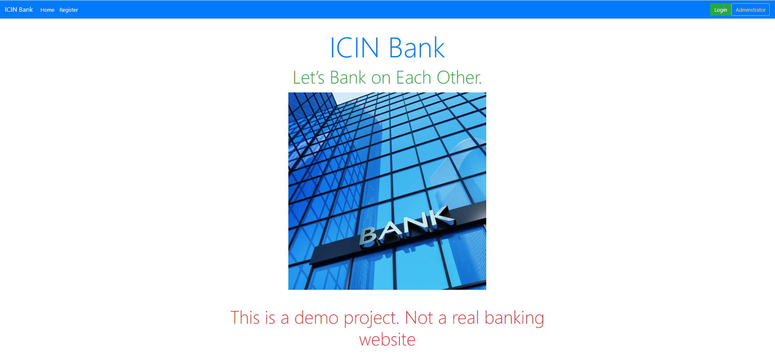
Home Page

Slide 3
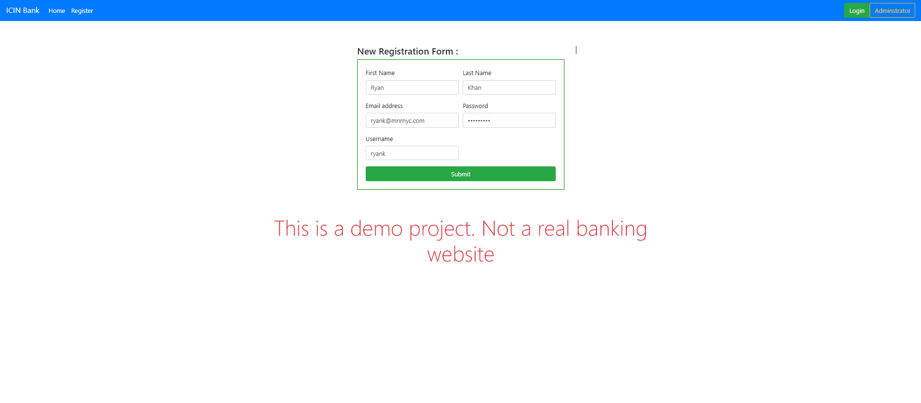
User Registration

Slide 4
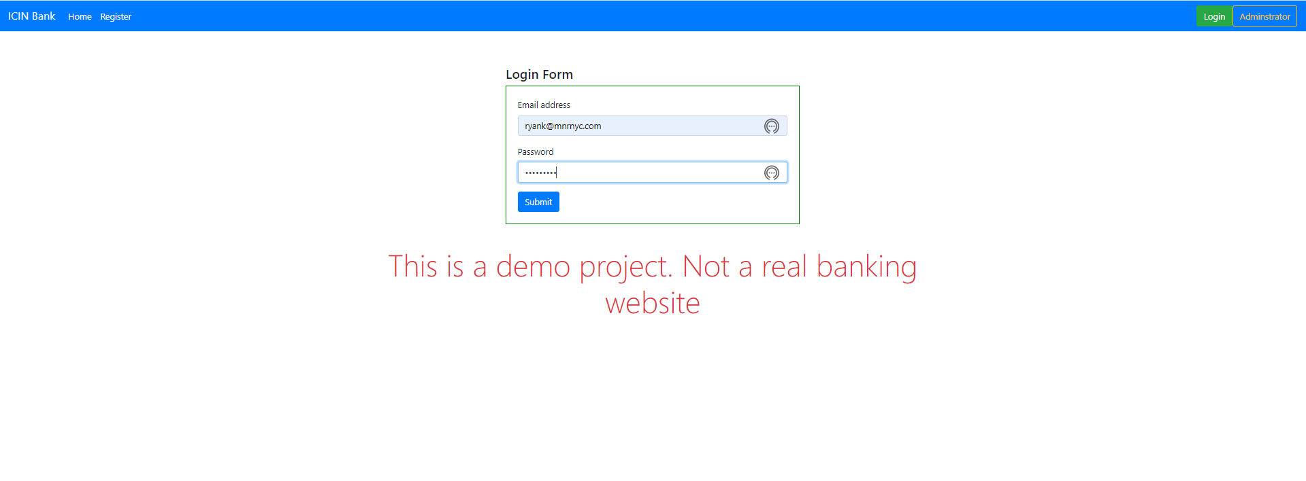
User Login

Slide 5
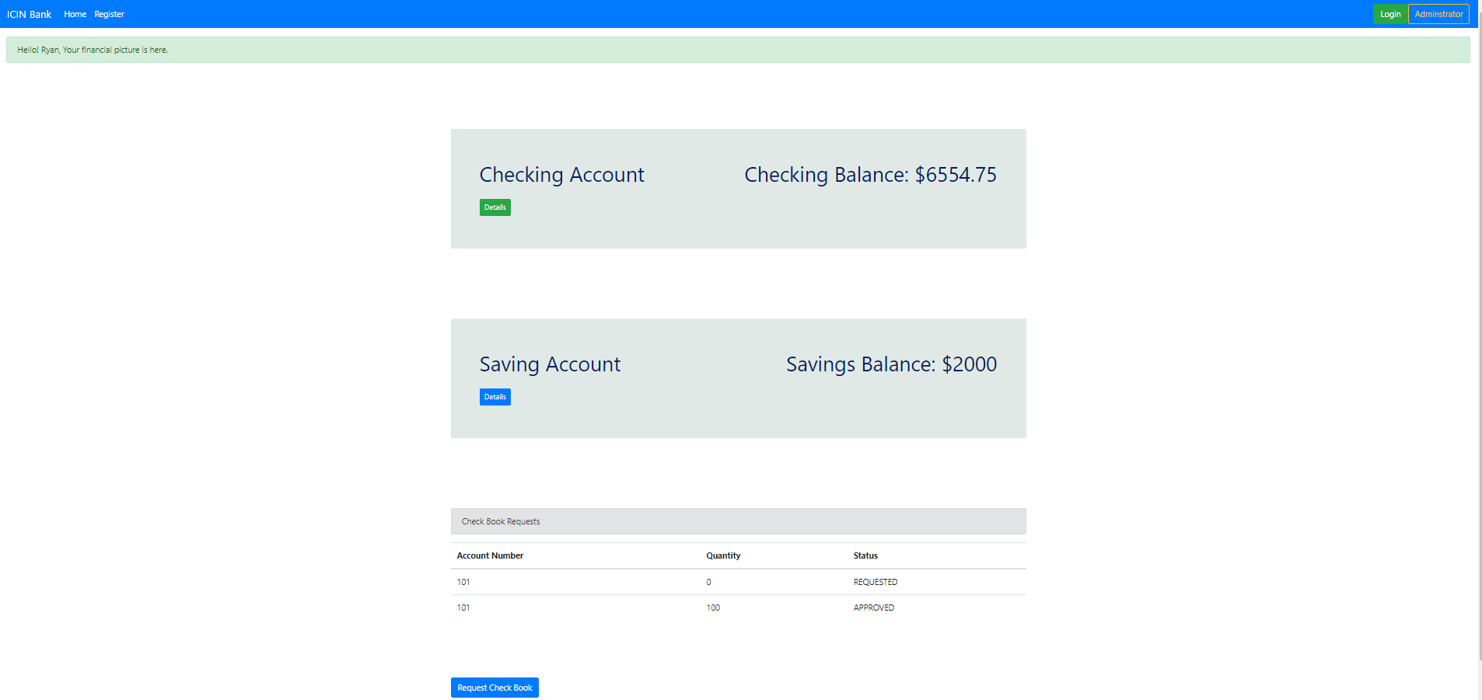
User Landing Page

Slide 6
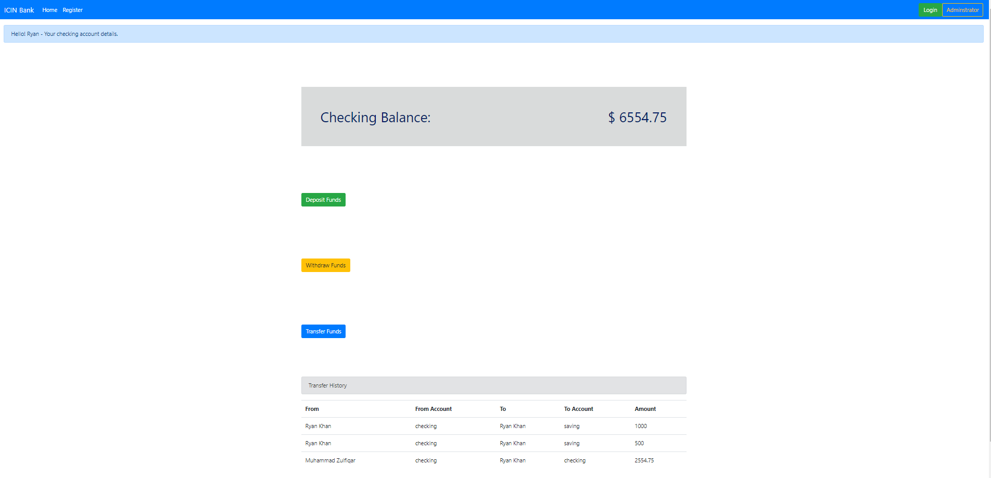
Checking Detail Page

Slide 7
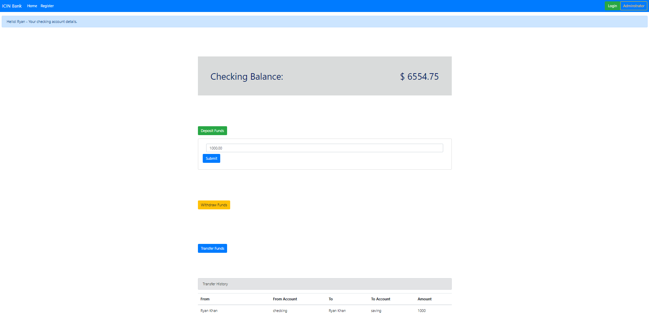
Checking Deposit Funds

Slide 8
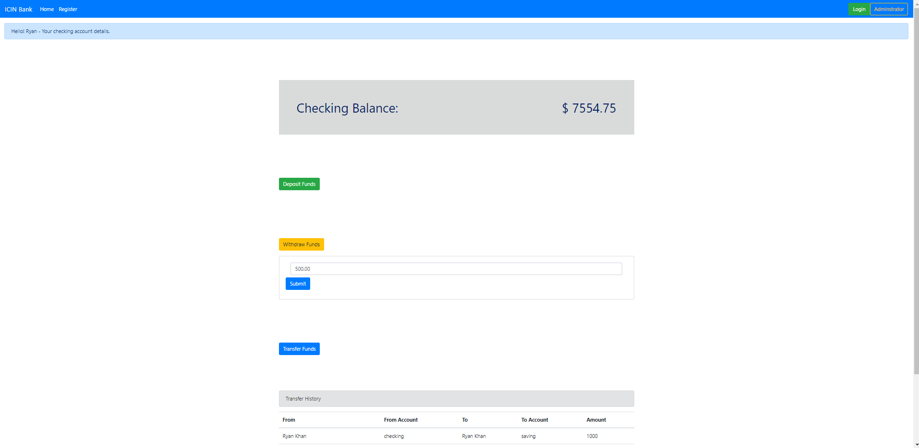
Checking Withdraw Funds

Slide 9
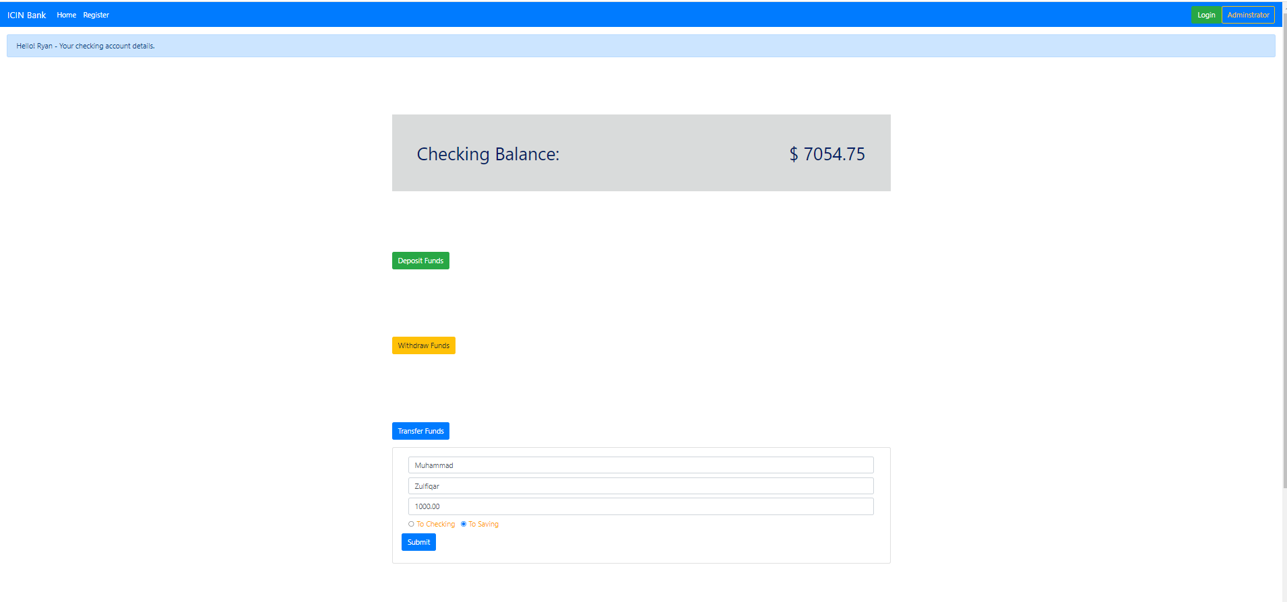
Checking Transfer Funds

Slide 10
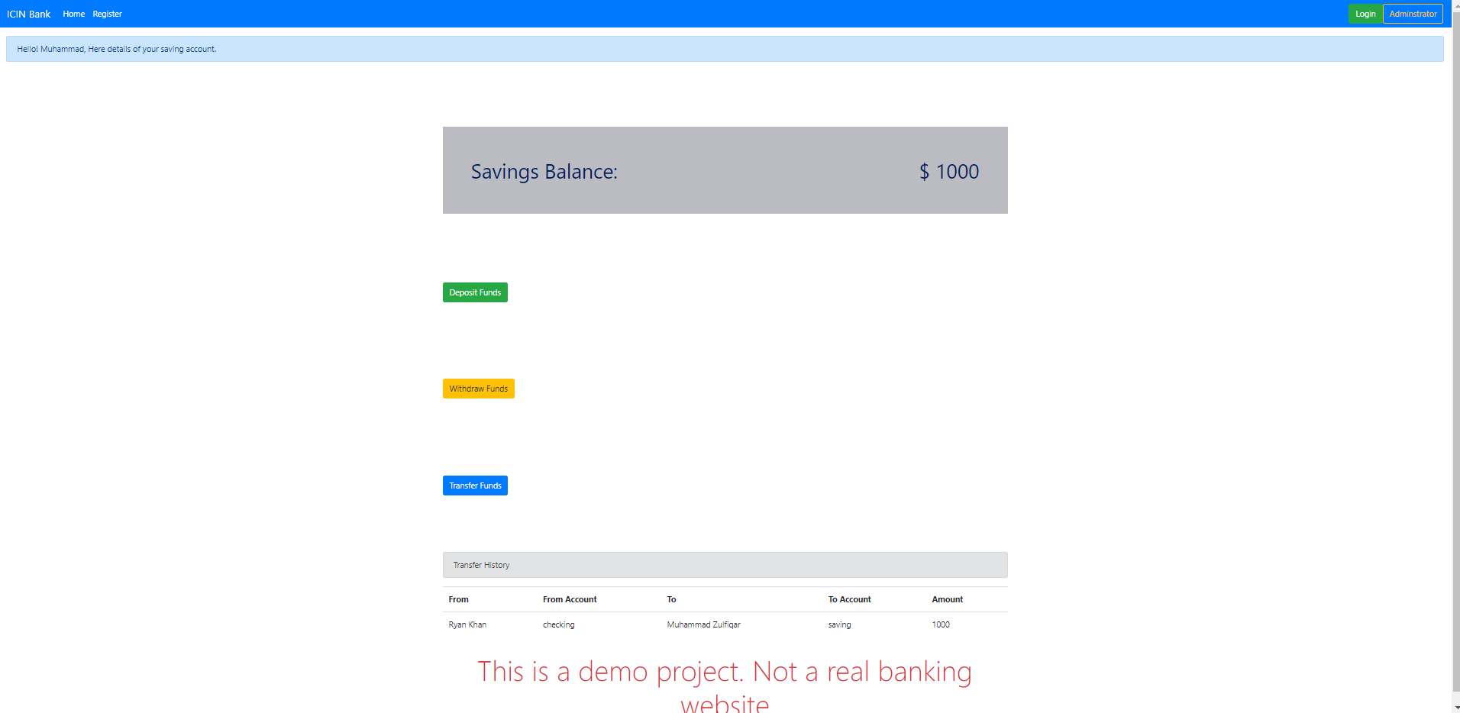
Savings Detail Page

Slide 11
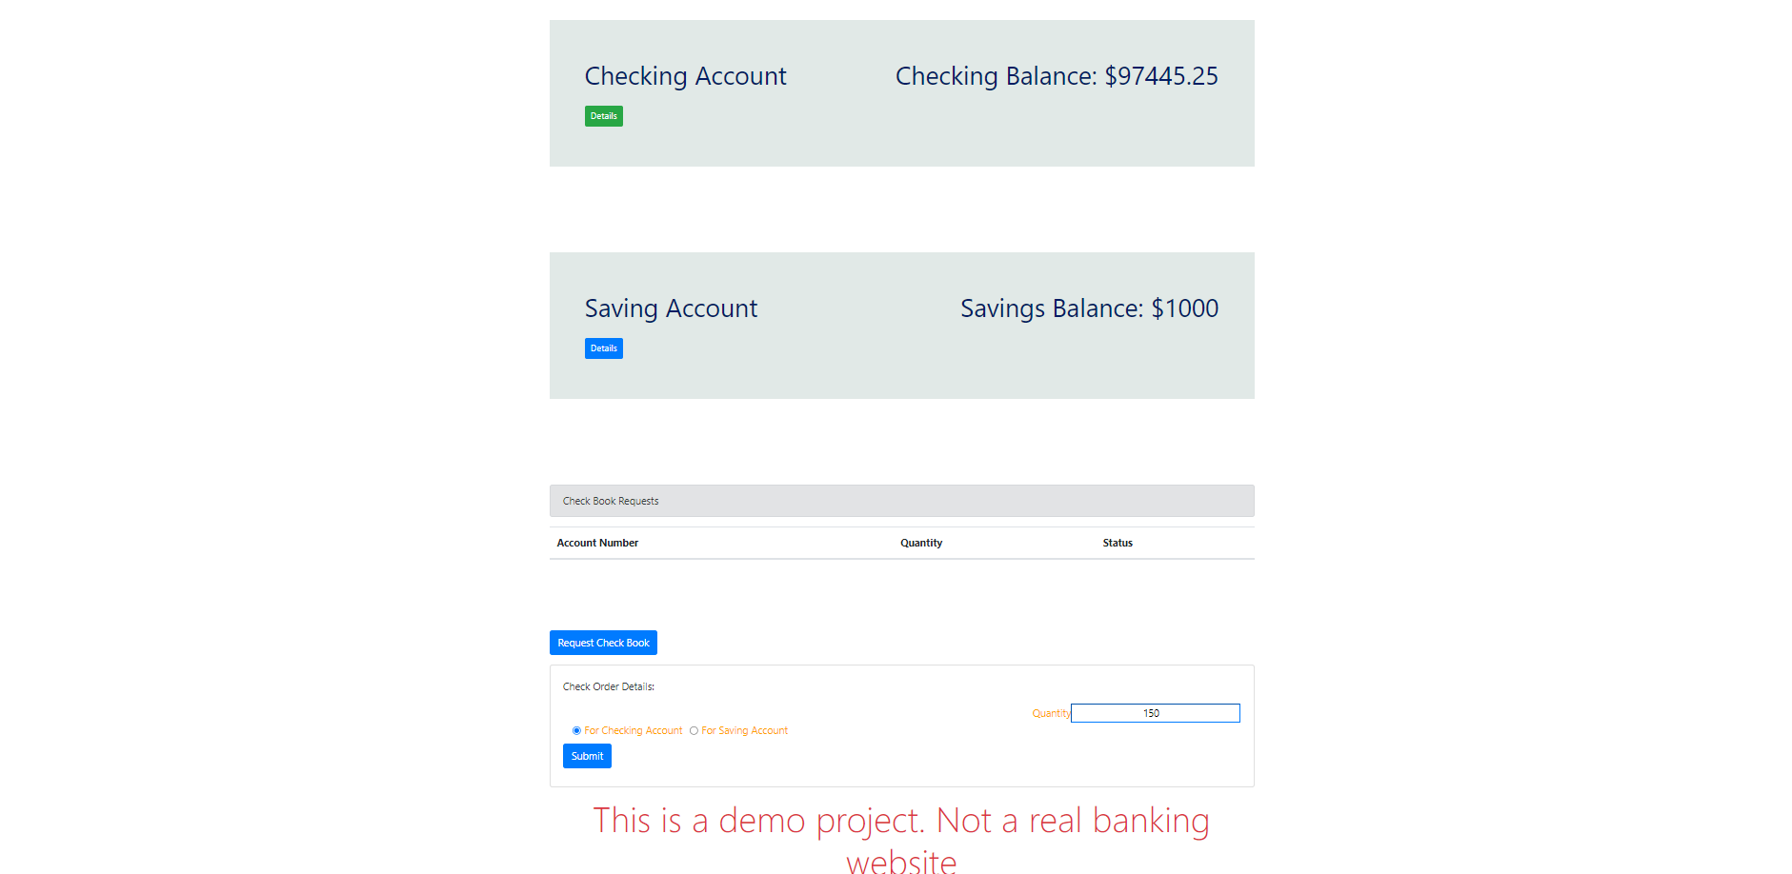
Check Request Page

Slide 12

Admin Login Page

Slide 13
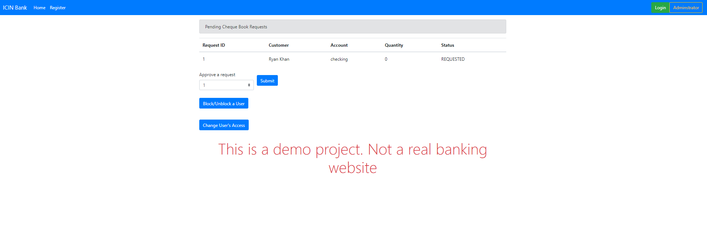
Admin Landing Page

Slide 14
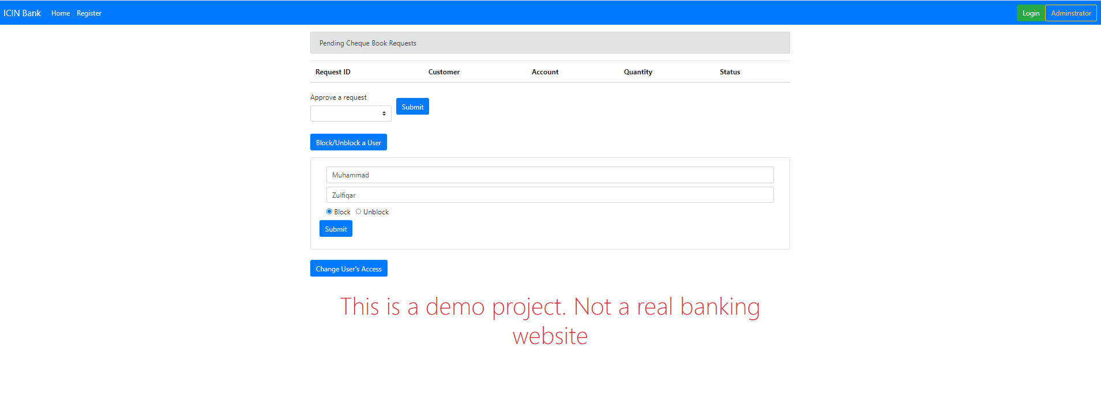
Admin Block User

